Slide 1







Slide 2

Members
Zavarynskiy Nazar
Kromkach Vladyslav
Blyzniuk Andrian
Chycherskiy Vitaliy
Stefanyshyn Nazar
Klochnyk Yaroslav
Mentor

Slide 3
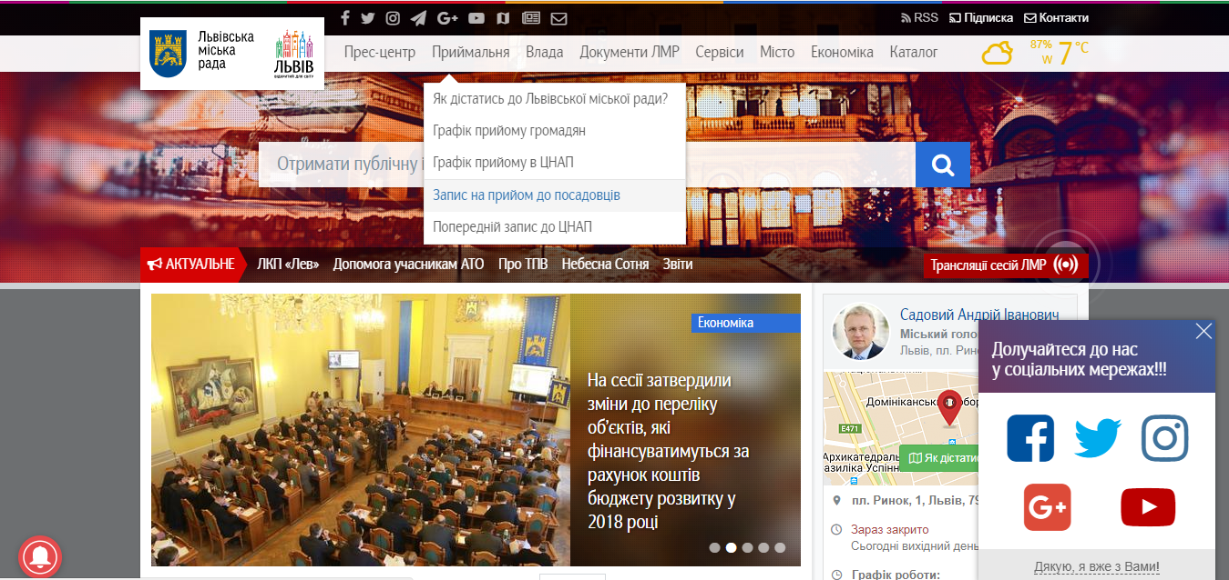
PROBLEM IS…
People who want to subscribe to a CNAP or a particular official person can do it only through the web-site, so it is not very convenient……so the mobile app is a good option to improve the situation.

Slide 4



The advantages of our project
Opponents:
See the queue state
Users can subscribe to a CNAP
…to an audience with official person.
Add a response
Online support
Register of services
Web version in the app
- Long load time
+ The same functionality - Design

Slide 5





FRONT-END
BACK-END
Mobile User App
Server
Request
HTTP(S)Protocol
Response
Request
Request
Response
Response
HTTP(S)Protocol, JSON Data
Admin Web
Database

Slide 6




MOBILE
What we used?
Java Android
Retftofit2
Aes + cipher encryptor/decryptor

Slide 7




WEB
What we used?
HTML/CSS
JS
Jquery/Jquery UI
Bootstrap

Slide 8





BACK-END
What we used?
Python
Django
Django rest framework
Python anywhere
Cipher + aes encryptor/decryptor
Cors-headers
Django-filters
Database : MySQL

Slide 9


Communication
What we used?
Version control : GitHub
Task controller: Trello

Slide 10
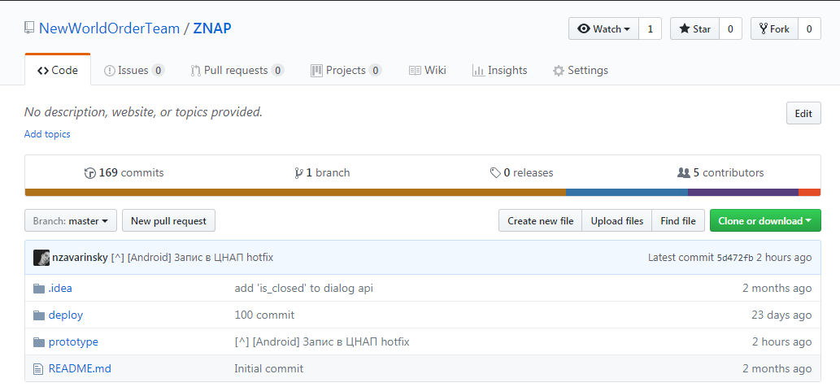
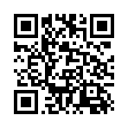
OUR GITHUB REPO

Slide 11
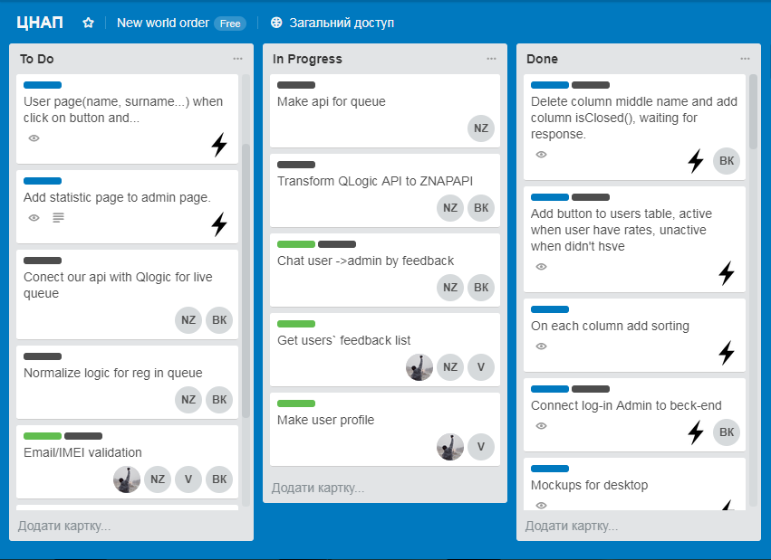
OUR TRELLO

Slide 12
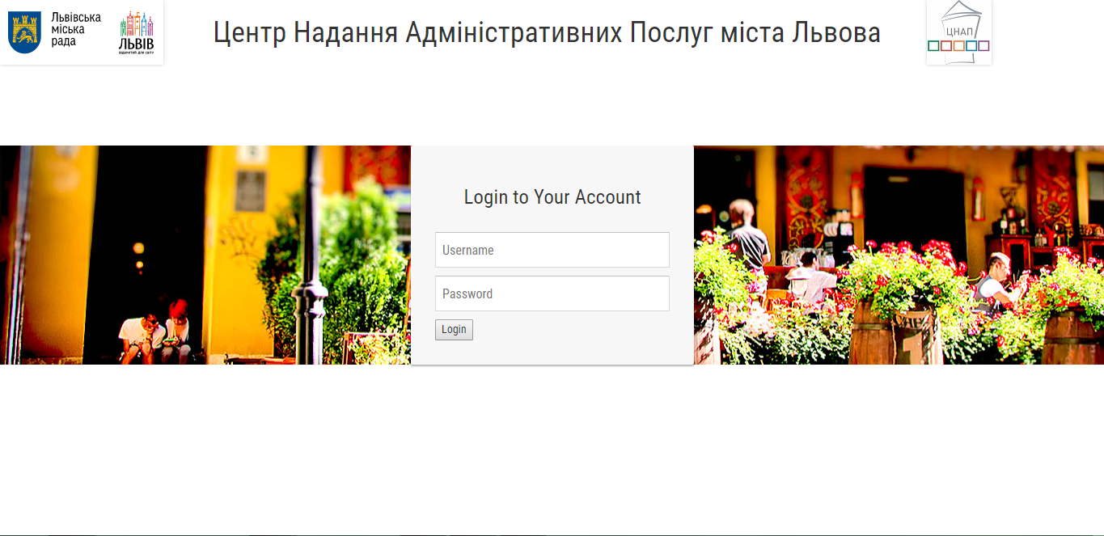

Slide 13
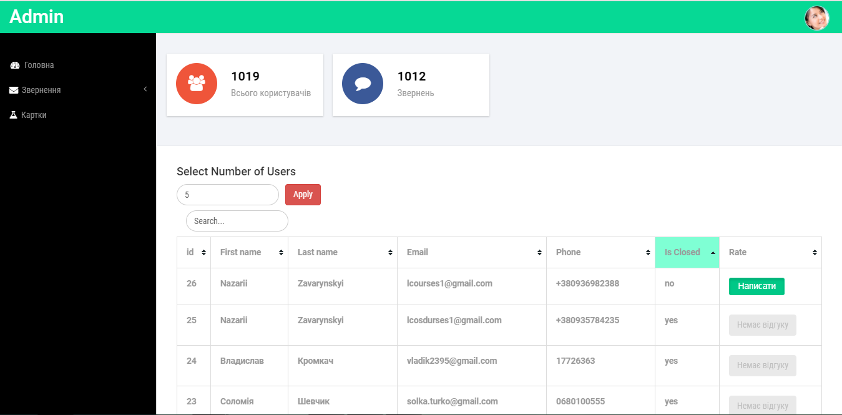

Slide 14
DE O
M
Тут буде відео

Slide 15


FUTURE PLANS
What we will do?
Integration with Qlogic
Finish Admin page
Security
Play Market (approximately May, 2019)

Slide 16

Any Questions

